Slide 1

BMS INSTITUTE OF TECHNOLOGY AND MANAGEMENT
Department Of Electronics and Telecommunication Engineering
On
A Premium website template for musicians
Presented By:
Student Name :RAM KMAR
USN : 1BY20ET046
Under the guidance of:
Internal Guide:
Dr. SOWMYASHREE MS
Assistant professor (ETE)
External Guide:
Nithin K S
Project Manager

Slide 2
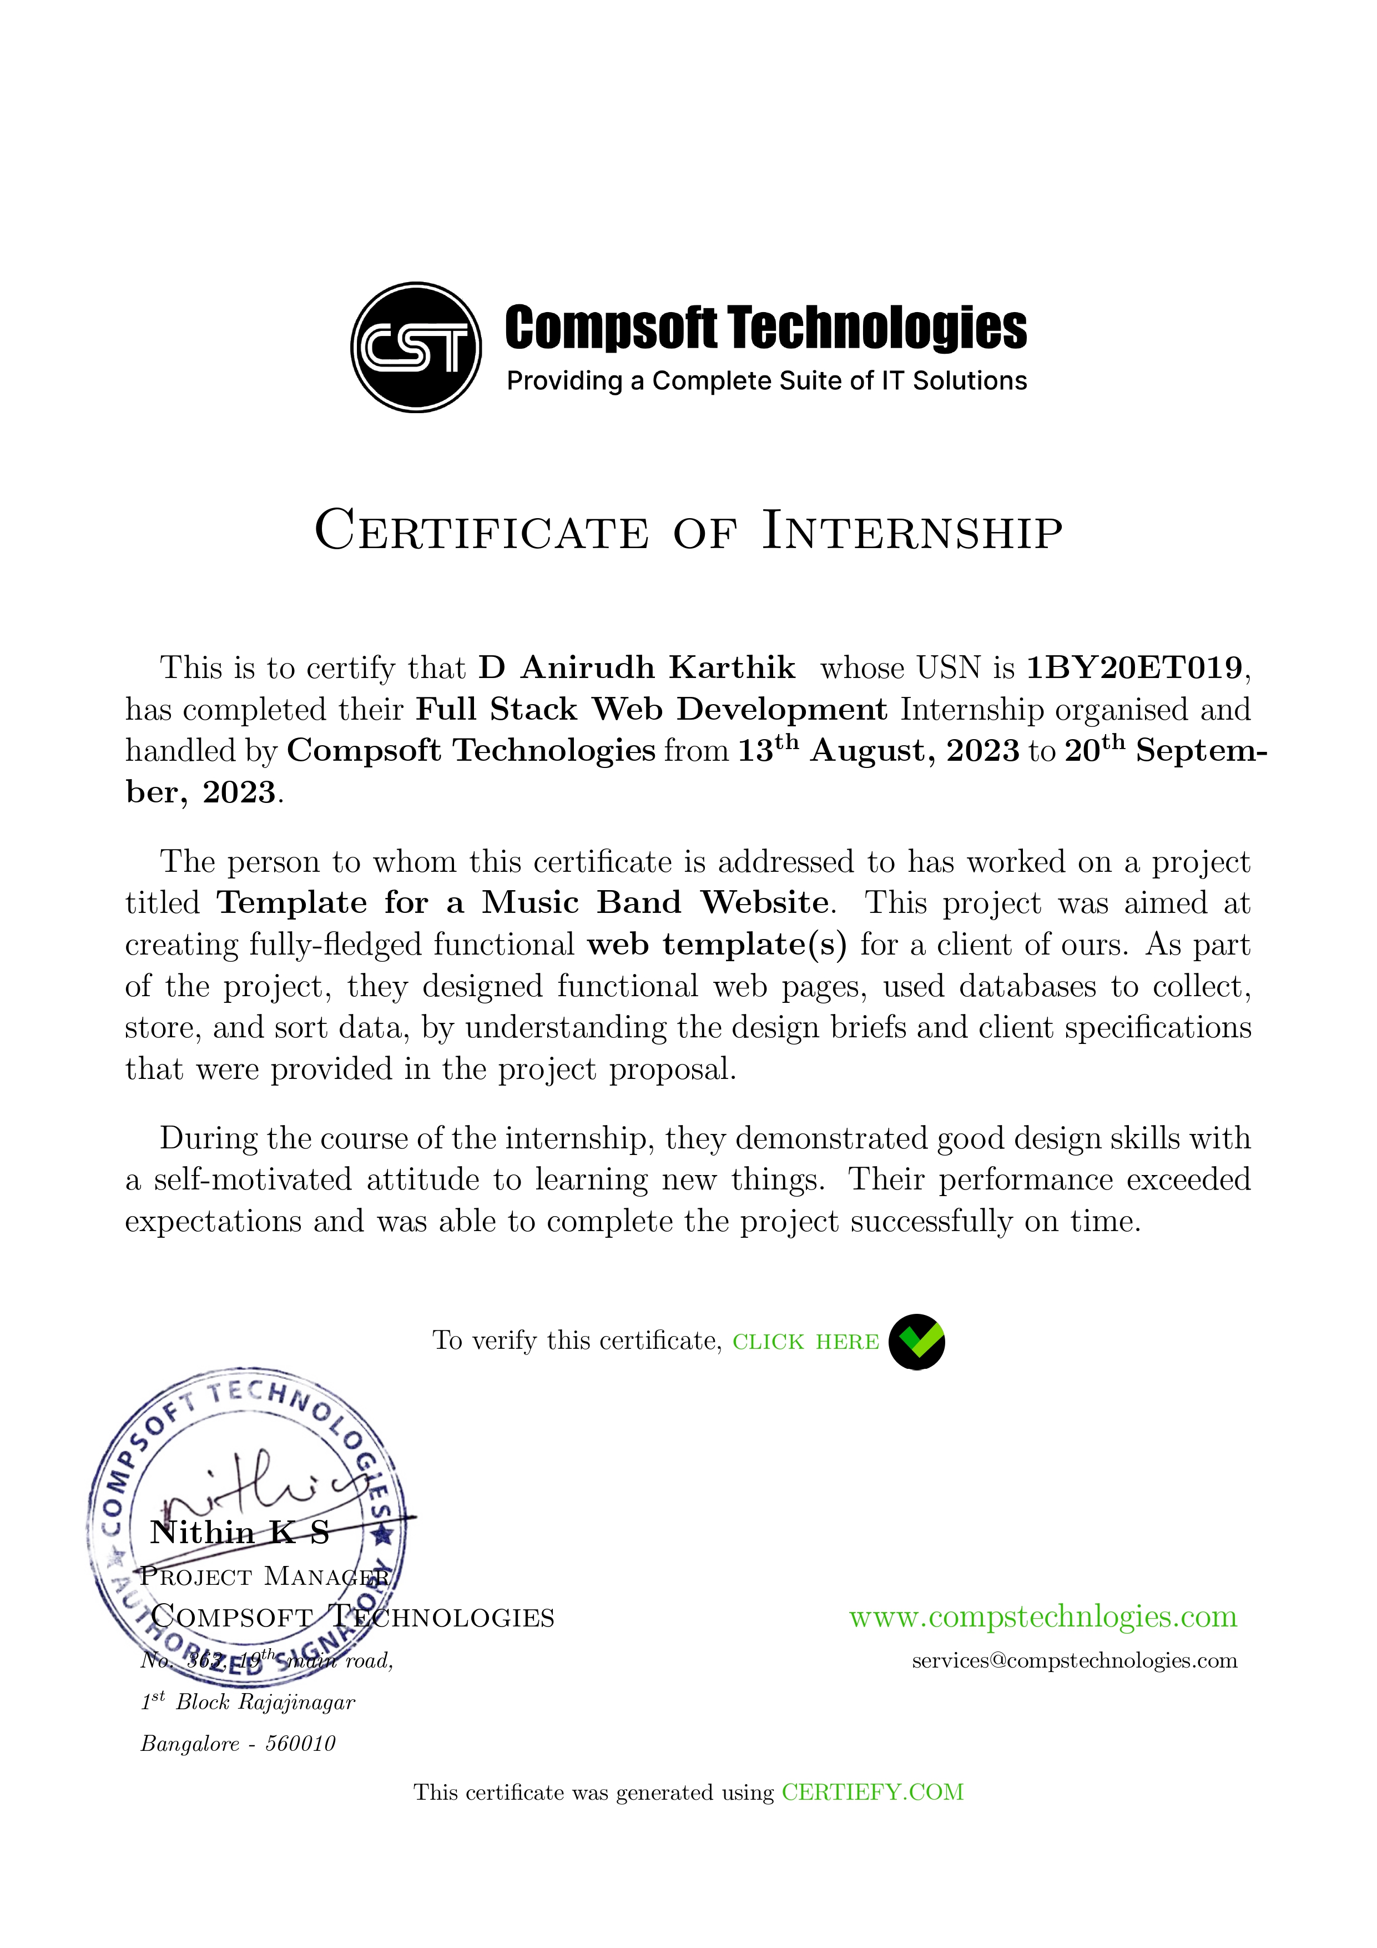
Internship Certificate

Slide 3
CONTENTS:
Abstract
About the company and Department
Introduction
Problem statements
Objectives
Weekly Overview Of Internship Activities
Tasks performed
Technical topics learnt
Results
Learning outcomes
Conclusion

Slide 4

About the company
Compsoft Technologies is a Technology Organization providing solutions for all web design and development, MYSQL, PYTHON Programming, HTML, CSS, ASP.NET and LINQ.
The organization where they have a right mix of professionals as a stakeholders to help us serve our clients with best of our capability and with at par industry standards.
They have young, enthusiastic, passionate and creative Professionals to develop technological innovations in the field of Mobile technologies, Web applications as well as Business and Enterprise solution.
Motto of the organization is to “Collaborate with our clients to provide them with best Technological solution hence creating Good Present and Better Future for our client which will bring a cascading a positive effect in their business shape as well”.

Slide 5
ABSTRACT
The musical band website, meticulously designed and developed using full-stack development techniques, invites you to explore the intersection of artistry and innovation.
Embark on a digital adventure through our website, where the art of music meets the prowess of technology.
Dive into the intricate architecture and seamless functionality that powers our online presence.
The full-stack development team has carefully engineered a user-friendly interface that offers not only an auditory delight but also a visually engaging experience.
Discover our multifaceted musical identity, as we harmonize various genres and styles into a symphony of sound.
The website presents a dynamic showcase of our music, enriched with multimedia features such as audiovisual performances and interactive playlists

Slide 6
INTRODUCTION
Web applications are similar to the traditional applications you’d install on your Information, such as Microsoft Office.
They are able to perform the same kinds of tasks, they look the same and they feel the same but there is one key difference - the application itself is not installed on your phone or Information, but lives in the cloud.
Web apps are not new, but it used to be that they were often unable to compete with more traditional applications for business critical functions or where rich user interaction was required.
This is no longer the case. With the power of modern web technologies, we are able to design and build performing, secure, and feature rich applications that live in the cloud and bring with them a huge number of benefits.

Slide 7
Problem Statement
To develop an application which facilitates creation of web pages having a need to install any HTML editor based software
To develop a webpage which can be used by any novice user that is developing web pages on the online.
This module is designed to reduce the process involved in managing the activity of customers and business where the business can sell their services and the customers can buy those.

Slide 8

OBJECTIVES
To design a high responsive and an attractive homepage
To provide the client with the stats of the consumers
To design a fast ,multi platform supporting webpage
Delivering the most efficient and the best solution to our clients to every client leveraging leading technologies & industry best practices.

Slide 9
Weekly view of internship activity
Week | Overview
Week 1 | Orientation and introduction
Week 2 | Learning about the technologies used in the project
Week 3 | Creating a Flowchart and adding in all the different variables and parameters
Week 4 | Problem-solving and iterative improvement
Week 5 | Project completion and presentation

Slide 10
Tasks Performed
1)Website Development: Interns are often involved in developing or assisting in the development of websites. This may include tasks such as coding HTML, CSS, and JavaScript for frontend development.
2)Responsive Design Implementation: Interns may work on ensuring that websites are responsive and optimized for various devices and screen sizes.
3)Collaboration and Version Control: Interns typically collaborate with team members using version control systems like Git.

Slide 11
Technical topics learnt
HTML (Hypertext Markup Language)
CSS (Cascading Style Sheets)
JavaScript
Responsive Web Design
Web Development Frameworks (e.g., Bootstrap)

Slide 12
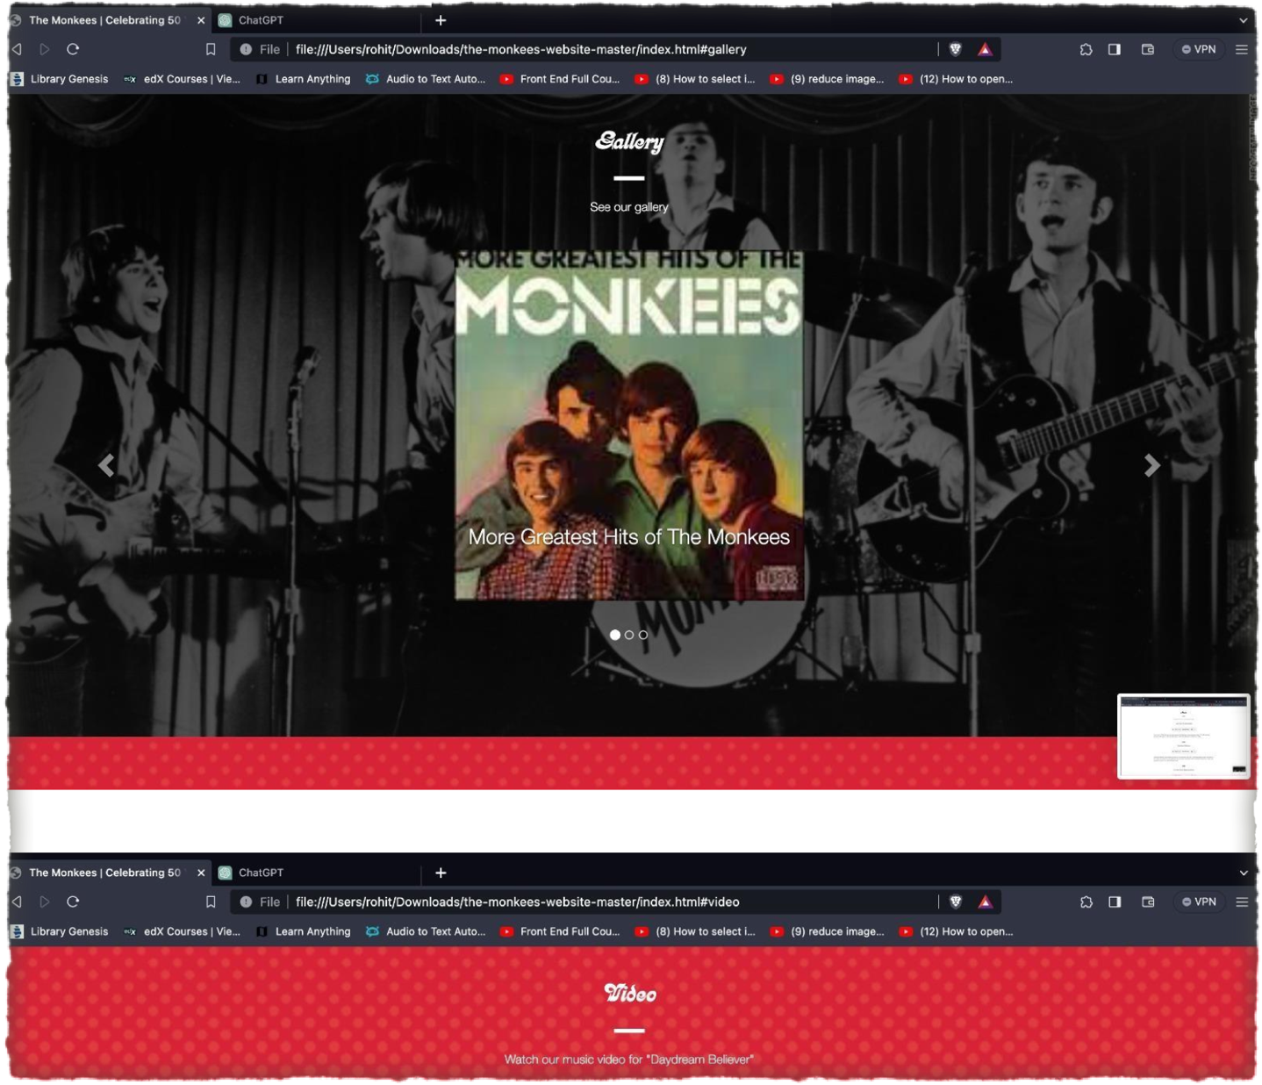
Results

Slide 13
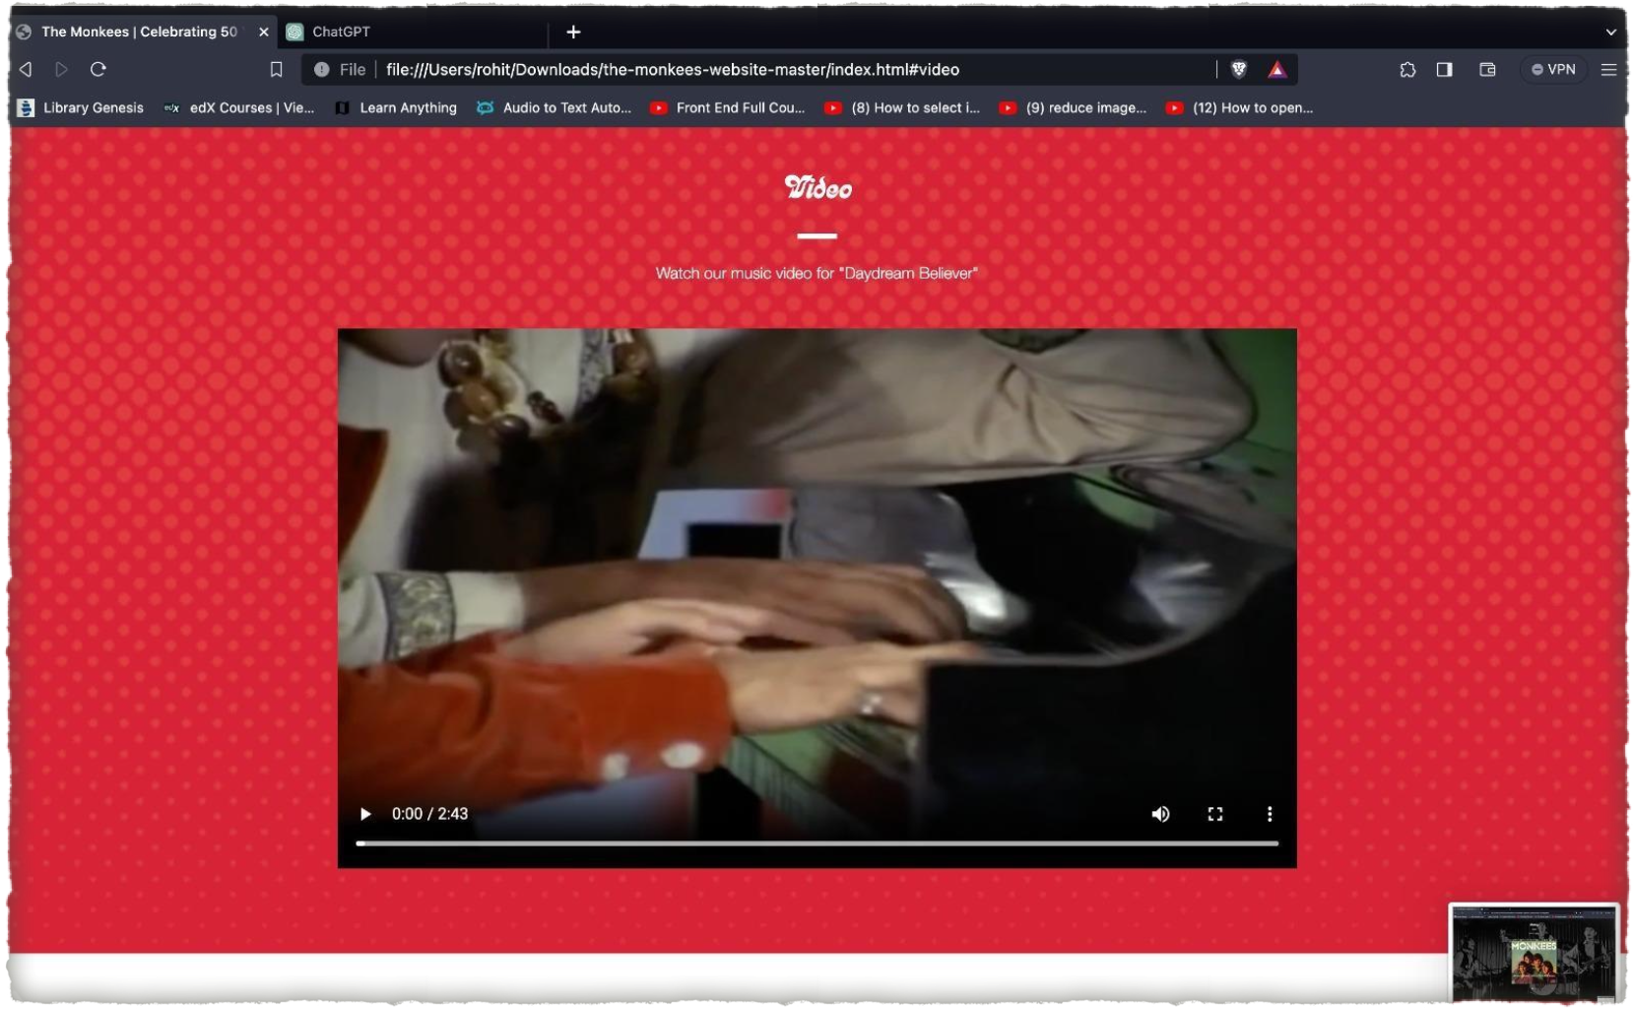

Slide 14
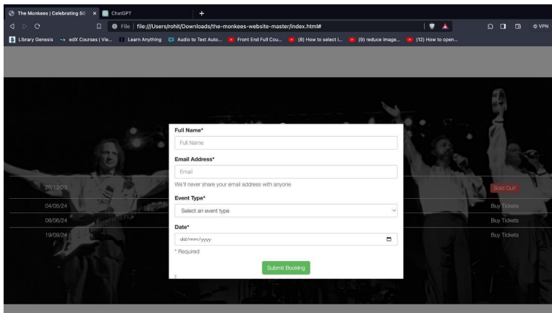
Registration portal

Slide 15
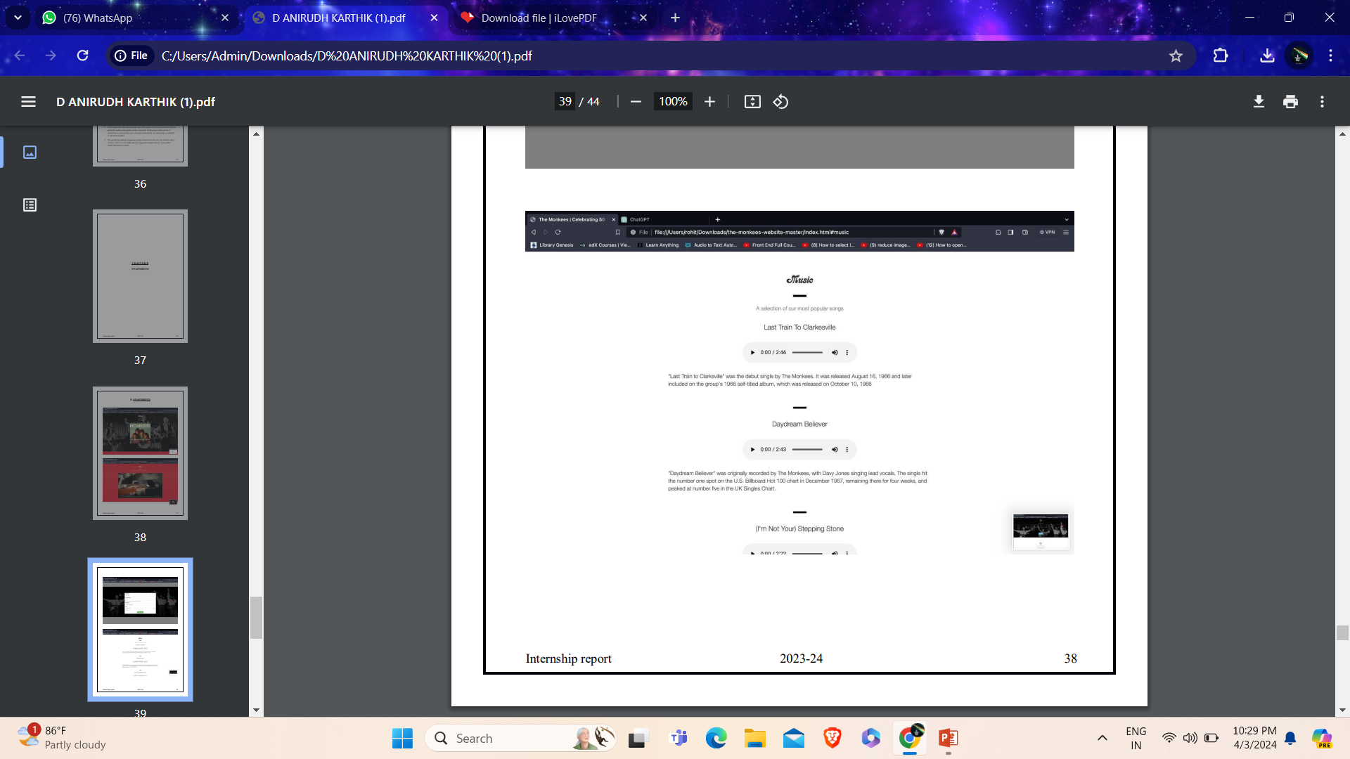
MP3 player

Slide 16
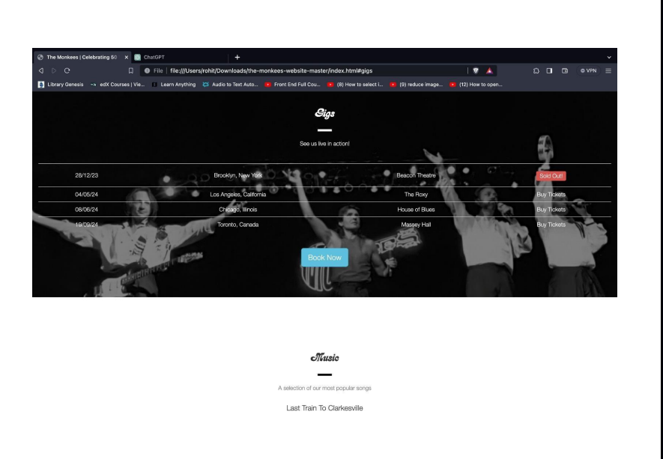
Concert Details

Slide 17
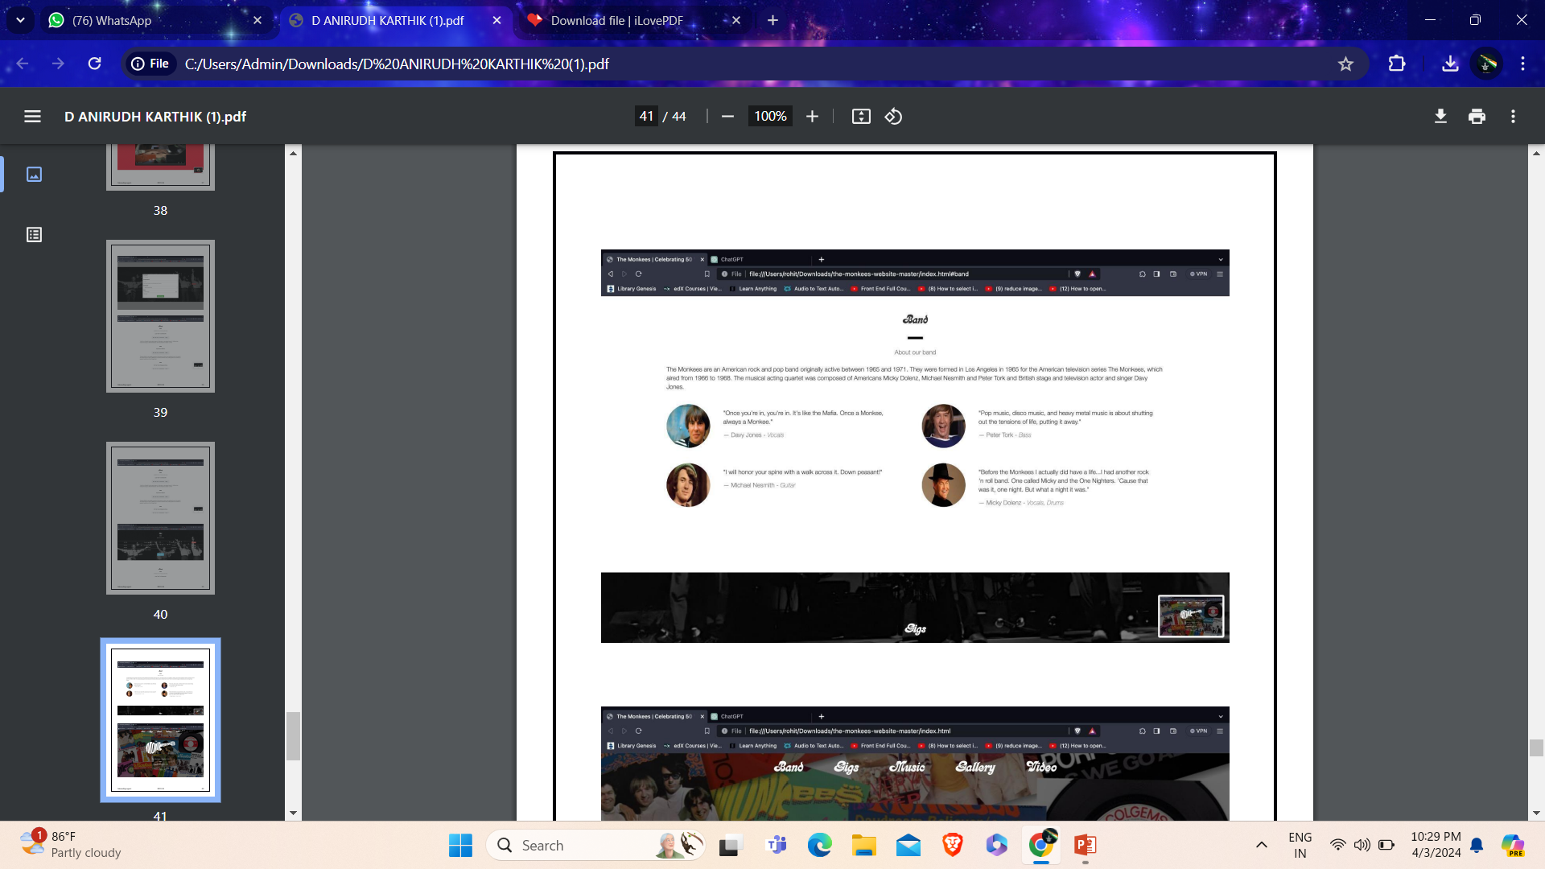
Reviews and Comments

Slide 18
Learning outcomes
Understanding of Web Technologies
Problem-Solving Skills
Project Management and Collaboration
User-Centric Design Principles
Testing and Quality Assurance

Slide 19
Conclusion
1)The package was designed in such a way that future modifications can be done easily.
2)Automation of the entire system improves the efficiency.
3) As part of the friendly graphical user interface which proves to be better when compared to the existing
4)Appropriate access is given to the authorized users depending on their permissions
Updating of information becomes so easier
5) System security, data security and reliability are the striking features
6)The System has adequate scope for modification in future if it is necessary.

Slide 20
References
1.
2.
3.
4.
5.
6.
7.
8.
https:www.w3school.com
https://www.tutorialspoint.com/java/
http://www.javatpoint.com/java-tutorial
https://docs.oracle.com/javase/tutorial/
https://www.coursera.org/
https://www.thenetninja.co.uk/
https://css-tricks.com/
https://github.com/

Slide 21
THANK YOU!

